Slide 1
Automatic Language Identification in Audio & Video clips

Slide 2

Team Members
Semester Presentation
IE 7860_Winter 2021
Akashdeep Balu
hc6943@wayne.edu
Kavya Nagaraju
hc3344@wayne.edu
Priyanka Patil
hc6653@wayne.edu

Slide 3
Agenda
Project Goal
Challenges
Our Approach
Results
Lessons Learned

Slide 4
Goal
Spoken Language Identification is the process of detecting the language of an utterance by an anonymous speaker, irrespective of gender, accent, and pronunciations.
Implementation of an acoustic model for Spoken Language Identification.
The major task is to extract features that could be used to distinguish between languages.

Slide 5
Challenges
Finding a Dataset.
Verifying if the Audio Clips are Sampled Consistently?
Fourier Transform (Spectral space) or Wavelets (Temporal & Spectral)?
Which approach is better: Doing Feature Engineering or relying on deep learning methods?

Slide 6
Our Approach
The Dataset includes 5 languages with 200 samples each is used for analysis.
Creating and plotting the spectrogram using librosa.
The audio is file converted into a Spectrogram which is a 2D matrix representing the frequency magnitudes along with time for a given signal.
We are further, training CNN models to classify the languages.
Model is also tested on video clips to identify languages.

Slide 7
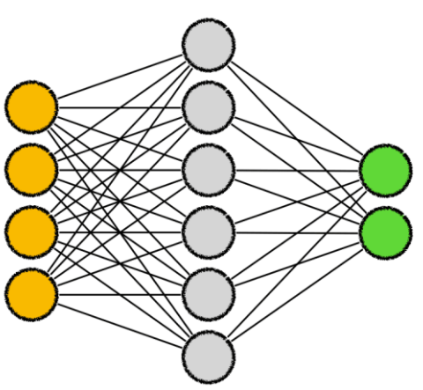
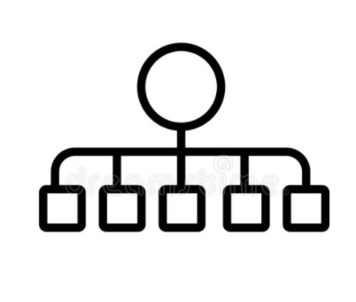

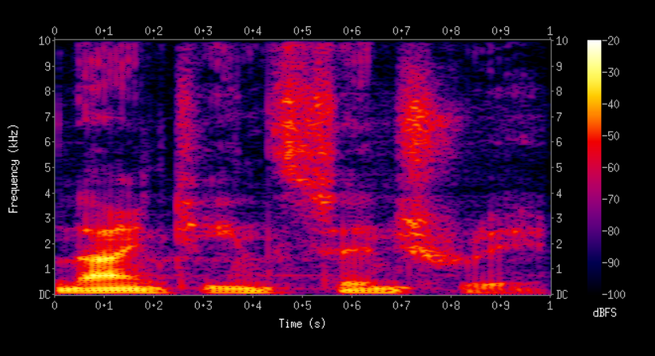
Our Approach
Audio Clip
Spectrogram
CNN Model
Language
Classifier
Steps Involved in Model Building

Slide 8
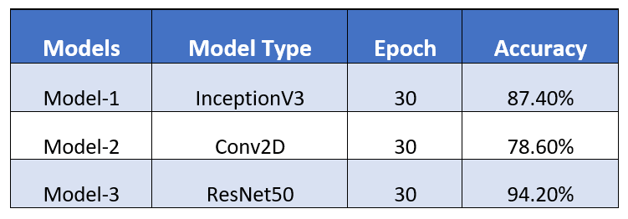
Results

Slide 9
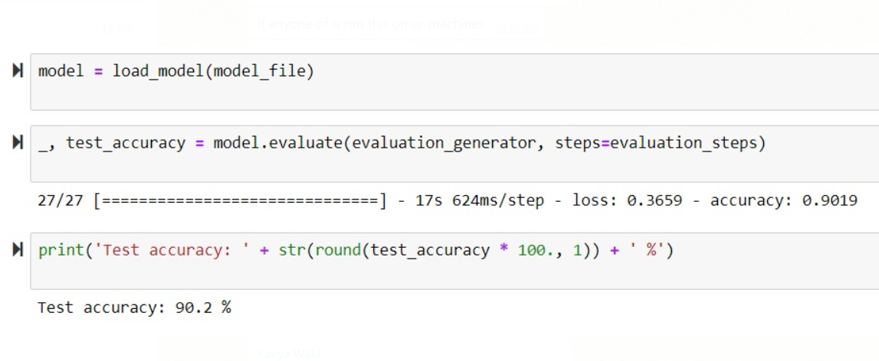
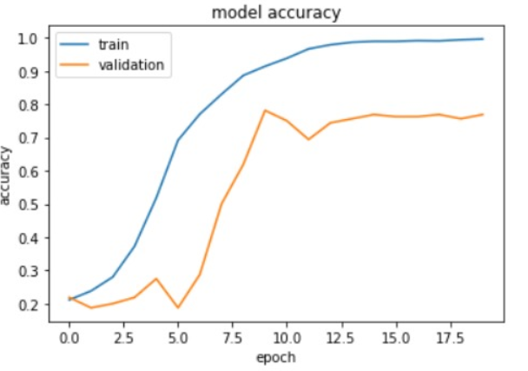
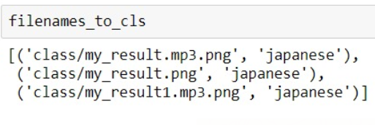
Results

Slide 10
Lessons Learned
Using the library librosa & moviepy to understand how audio feature extraction works before building the model.
Finding datasets was a challenge.
Keeping our model simple at first and then increasing the complexity of CNN layers and number of epochs as we started getting results. It helped us to troubleshoot our models and improve results.

Slide 11
Questions?

Slide 12
Thank You

